Slide 1
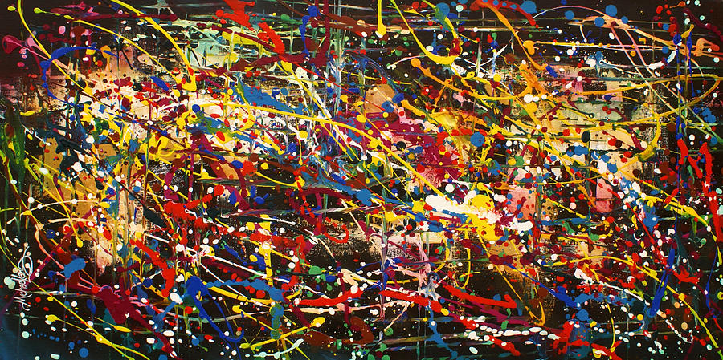
Simmy, the monkey for making chaos
By Geovanny Alzate Sandoval

Slide 2





About Me
Software Architect at StellarEmploy
vany0114
geovany0114
http://elvanydev.com/

Slide 3

What is Chaos Engineering?
Notes:
Es la disciplina de experimentar en un Sistema distribuido para asegurar que nuestras estrategias de resiliencia están bien implementadas y pueden soportar condiciones adversas en un ambiente productivo. En otras palabras, la idea ppal es inyectar fallas deliveradamente al Sistema de una manera controlada para observar el comportamiento del Sistema en condiciones adversas y aprender como hacerlo más resiliente.
***Mention principles*** document maintained by the community

Slide 4

When, why and how it was born?
Notes:
When: back in 2011 when Netflix was migrating their services from their datacenters to the cloud
Why: lack of confidence in their resilience strategy
How: The chaos monkey then a full framework called the Simmian Army

Slide 5

Why resilience is important?
Notes:
Antes de empezar a hablar de como inyectar caos tenemos que saber porque el concepto de resiliencia es tan importante cuando construimos nuestras aplicaciones en una arquitectura distribuida. No podemos pensar en inyectar caos si ni siquiera tenemos estrategias de resiliencia implementadas.

Slide 6
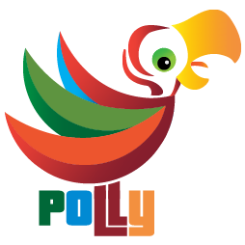
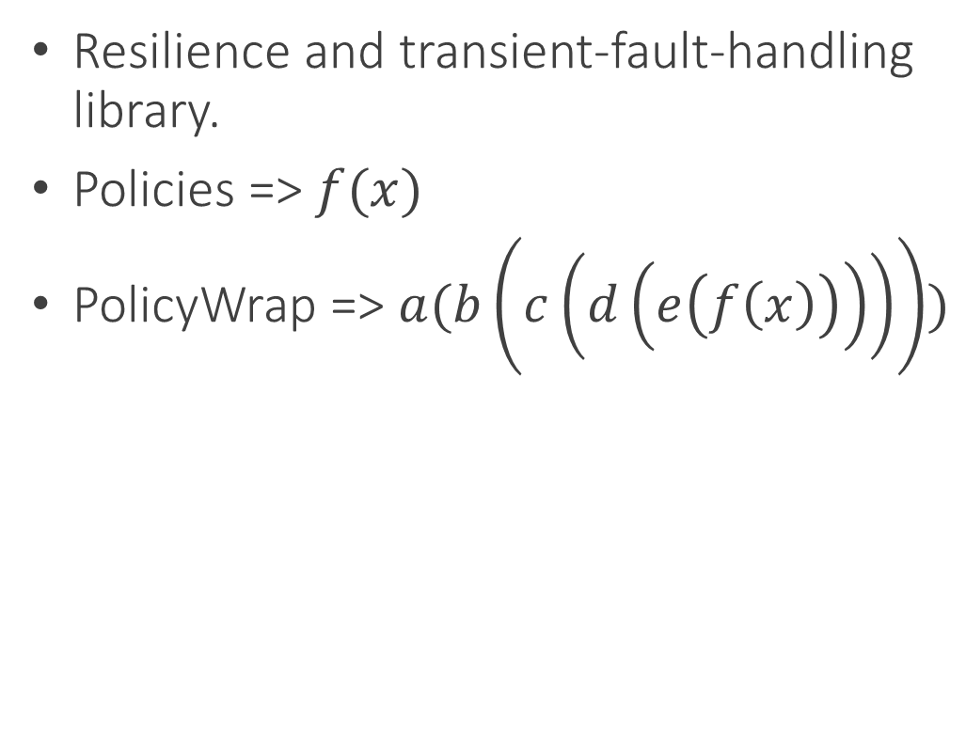
Polly
Resilience and transient-fault-handling library.
Policies => $f(x)$
PolicyWrap => $a(b\left(c\left(d\left(e\left(f\left(x\right)\right)\right)\right)\right))$
Notes:
Policies: the minimun unit of resilience. Retry, Wait and Retry, Circuit Breaker, Fallback, etc
PolicyWrap: more than one policy working together as a one policy which allow you to create resilience strategies.
Desde el punto de vista de la programación funcional o desde el punto de vista matemático
Función de orden superior: toma una o más funciones como entradas y retorna una función como salida.

Slide 7
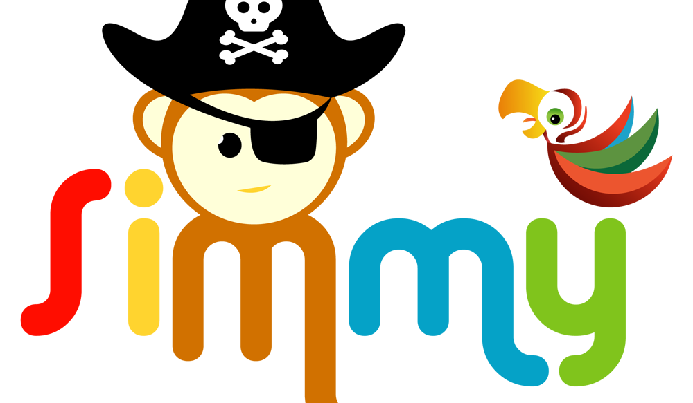
What is Simmy and when, why and how it was born?
Notes:
Simmy es un proyecto open source y una herramienta de ingeniería del chaos y de inyección de fallas basada en la idea de “The Simmian Army” de Netflix, que se integra con Polly.
When: September last year, released Jun this year
Why: .Net lack a chaos engineering/fault injection tool
How: we started to develop it as a feature of Polly, but we ended up developing as a separate project based on Polly.

Slide 8

How Simmy works?
Monkey Policies:
Fault
Latency
Behavior
* All chaos policies (Monkey policies) are designed to inject behavior randomly
Notes:
Simmy allows you to introduce a chaos-injection policy (Monkey Policy) or policies at any location where you execute code through Polly
Monkey Policies: minimum unit of chaos

Slide 9
How can Simmy help me out?
Is my system resilient enough?
Am I handling the right exceptions/scenarios?
How will my system behave if X happens?
How can I test without waiting for a handled (or even unhandled) exception to happen in my production environment?

Slide 10

Making chaos!!!

Slide 11

Demo!

Slide 12
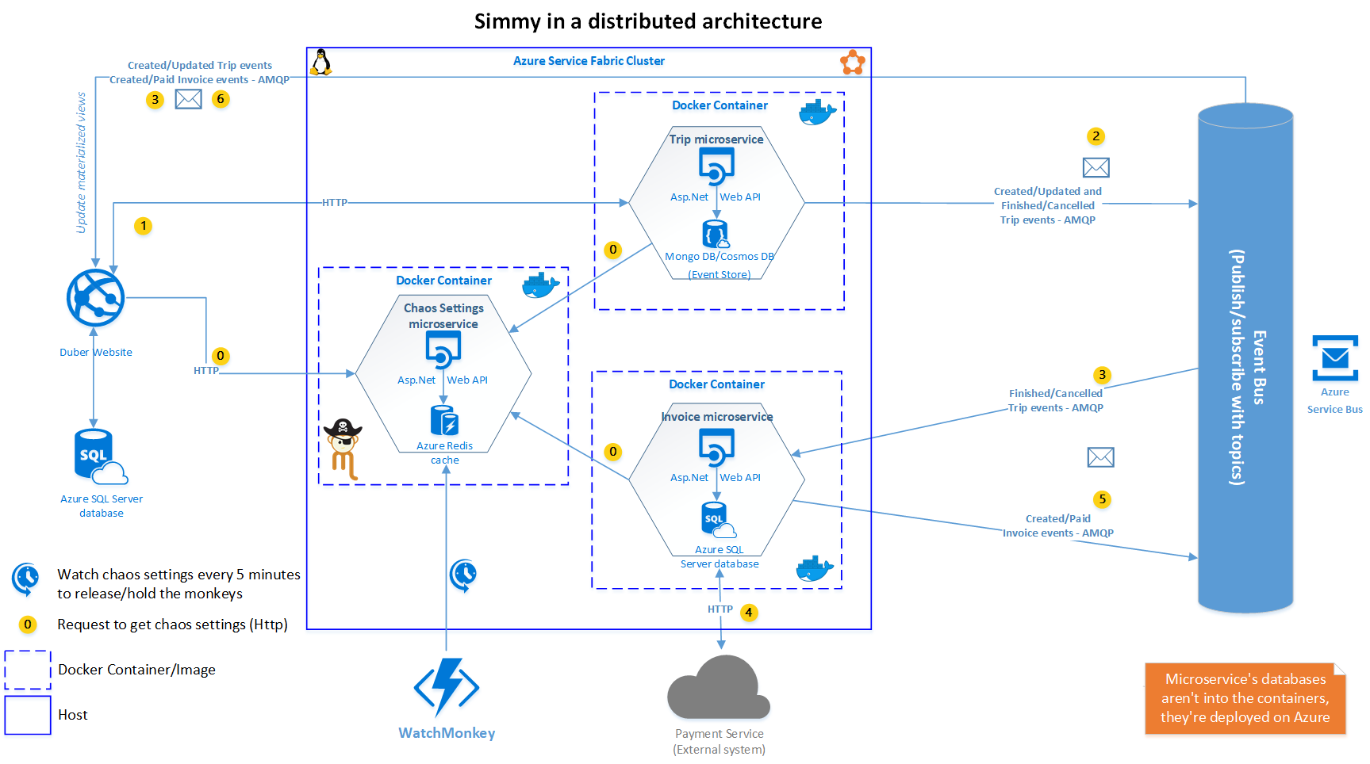
Architecture

Slide 13
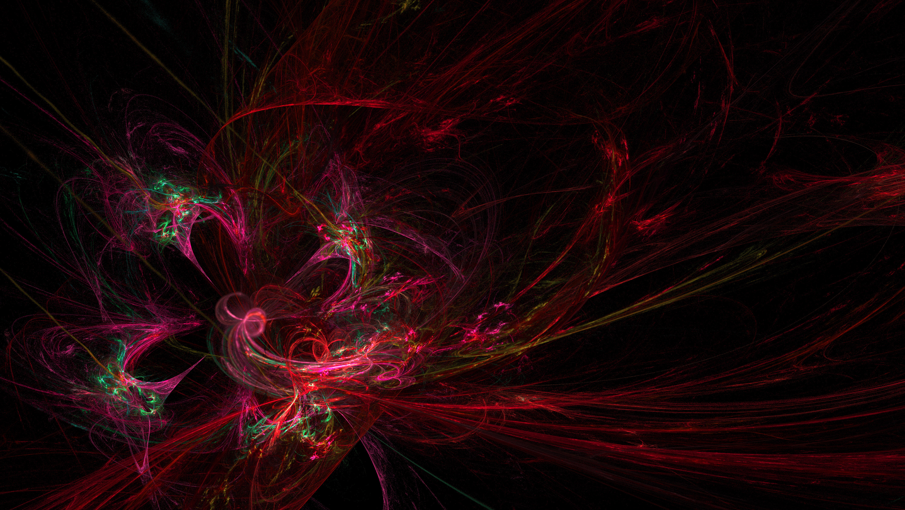
Wrapping up

Slide 14

Benefits
Mock failures of dependencies
Define when to fail based on some external factors
A way to revert easily, to control the blast radius.
Enable/disable chaos w/o any code changes.
Automation
Notes:
Mock failures of dependencies (any service dependency for example).
Define when to fail based on some external factors - maybe global configuration or some rule.
A way to revert easily, to control the blast radius.
Production grade, to run this in a production or near-production system with automation.

Slide 15

Challenges
Culture adoption
Mature monitoring & instrumentation
Cloud vendor specific
Limited tools for Azure
Notes:
Culture: it's more about the culture than a tool, tools just there to help us, but the most important thing is the companies adopt the culture
Monitoring: requires a good monitoring tool/strategy to be able to realize easily about system weaknesses and be aware where they are exactly, then be able to make decisions faster to fix them
Cloud vendor specific: every cloud vendor offers different API’s and SDK’s to interact to.
Limited tools for Azure: the majority of the chaos tools are built for AWS, such as “The Simian Army”, Gremly offers a couple of services that can be integrated with azure

Slide 16


Slide 17

Q & A

Slide 18
Thank You!
Software Architect at StellarEmploy
vany0114
geovany0114
http://elvanydev.com/

